Slide 2
Contents
Synchronization Hardware
Mutex Lock
Semaphores
Concepts
Implementation
Classical Problems
Bounded-Buffer
Readers and Writers
Dining-Philosophers
Monitors
Deadlock
Synchronization in Linux

Slide 3
Synchronization Hardware
Overview
Many systems provide hardware support for implementing the critical section code.
All solutions discussed in this section based on the idea of Locking
Protecting critical regions via locks.
Uniprocessors could disable interrupts to protect critical sections
Currently running code would execute without preemption
Generally too inefficient on multiprocessor systems
Modern machines provide special atomic hardware instructions:
non-interruptible
They either test one memory word and set value at once, or swap contents of two memory words.
We abstract the main concepts behind these types of instructions by describing two instructions.
test_and_set()
compare_and_swap()

Slide 4
Synchronization Hardware
Interrupt Disabling
Process P_{i}:
repeat
disable interrupts
critical section
enable interrupts
remainder section
forever
On a Uniprocessor
Mutual exclusion is preserved but efficiency of execution is degraded: while in critical section, we cannot interleave execution with other processes that are in remainder section.
On a Multiprocessor
Mutual exclusion is not preserved.
Critical section is now atomic but not mutually exclusive (interrupts are not disabled on other processors).

Slide 5
Synchronization Hardware
Special Machine Instructions
Normally, access to a memory location excludes other access to that same location.
Extension
Designers have proposed machine instructions that perform two actions atomically (indivisible) on the same memory location.
e.g., reading and writing
The execution of such an instruction is also mutually exclusive even on Multiprocessors.

Slide 6
Synchronization Hardware
Solution to Critical Section Problem using Locks
The general layout of lock solution is:
do {
acquire lock
critical section
release lock
remainder section
} while (TRUE);

Slide 7
Synchronization Hardware
Test_and_Set Synchronization Hardware Instruction
Testing and setting (modifying) the content of a memory word atomically (a Boolean version):
boolean TestAndSet(boolean *target)
{
boolean rv = *target;
*target = TRUE;
return rv;
}
It is executed atomically.
returns the original Boolean value of the passed parameter
set the new value of the passed parameter to “TRUE”.
The Boolean function represents the essence of the corresponding machine instruction.

Slide 8
Synchronization Hardware
Test_and_Set Synchronization Hardware Instruction
Mutual Exclusion with test_and_set instruction
Shared data:
boolean lock = FALSE;
Process P_{i}:
do {
while (TestAndSet(&lock))
; /* busy waiting */
critical section
lock = FALSE;
remainder section
} while (TRUE);

Slide 9
Synchronization Hardware
Test_and_Set Synchronization Hardware Instruction
Another test_and_set Example
A description of the machine instruction of test_and_set:
bool testset(int &i)
{
if (i == 0) {
i = 1;
return TRUE;
} else {
return FALSE;
}
}

Slide 10
Synchronization Hardware
Test_and_Set Synchronization Hardware Instruction
Another test_and_set Example
An algorithm that uses test_and_set for Mutual Exclusion:
Shared variable b is initialized to 0;
Only first P_{i} who sets b enters critical section.
Shared data:
int b = 0;
Process P_{i}:
repeat
repeat {
; /* busy waiting */
} until testset(b);
critical section
b = 0;
remainder section
forever

Slide 11
Synchronization Hardware
Test_and_Set Synchronization Hardware Instruction
test_and_set Instruction at Assembly Level
enter_region:
TSL REGISTER, LOCK | copy lock to register and set lock to 1
CMP REGISTER, #0 | was lock zero?
JNE enter_region | if it was nonzero, lock was set, so loop
RET | return to caller, critical region entered
leave_region:
MOVE LOCK, #0 | store a zero in lock
RET | return to caller
TSL: test and set lock instruction of atomic.
Storage BUS will be locked during its executing time to provide the guarantee of exclusion.

Slide 12
Synchronization Hardware
Swap Synchronization Hardware Instruction
Atomically swap (exchange) two variables:
void Swap(boolean *a, boolean *b)
{
boolean temp = *a;
*a = *b;
*b = temp;
}
This procedure represents the essence of the corresponding machine instruction.

Slide 13
Synchronization Hardware
Swap Synchronization Hardware Instruction
Mutual Exclusion with swap instruction
Shared data:
boolean lock = FALSE;
Process P_{i}:
do {
/* Each process has a local Boolean variable key */
boolean key = TRUE;
while (key == TRUE) /* busy waiting */
swap(&lock, &key);
critical section
lock = FALSE;
remainder section
} while (TRUE);

Slide 14
Synchronization Hardware
Swap Synchronization Hardware Instruction
swap instruction at Assembly Level
enter_region:
MOVE REGISTER, #1 | copy a 1 to the register
XCHG REGISTER,LOCK | swap the contents of the register and lock
| variable
CMP REGISTER, #0 | was lock zero?
JNE enter_region | if it was nonzero, lock was set, so loop
RET | return to caller, critical region entered
leave_region:
MOVE LOCK, #0 | store a zero in lock
RET | return to caller
XCHG: exchange instruction of atomic.
Storage BUS will be locked during its executing time to provide the guarantee of exclusion.

Slide 15
Synchronization Hardware
Compare_and_Swap Synchronization Hardware Instruction
The compare_and_swap instruction operates on three operands;
int compare_and_swap(int *value, int expected, int new_value)
{
int temp = *value;
if (*value == expected)
*value = new_value;
return temp;
}
executed atomically
returns the original value of the passed parameter value
set the variable value the value of the passed new_value but only if the comparison “value == expected” is true
That is, the swap takes place only under this condition.

Slide 16
Synchronization Hardware
Compare_and_Swap Synchronization Hardware Instruction
Mutual Exclusion with compare_and_swap instruction
Shared data
integer lock = 0;
Solution:
do {
while (compare_and_swap(&lock, 0, 1) != 0)
; /* busy waiting */
critical section
lock = 0;
remainder section
} while (true);

Slide 17
Synchronization Hardware
Disadvantages of Special Machine Instructions
Busy-waiting is employed, thus while a process is waiting for access to a critical section it continues to consume processor time.
No Progress (Starvation) is possible when a process leaves critical section and more than one process is waiting.
They can be used to provide mutual exclusion but need to be complemented by other mechanisms to satisfy the bounded-waiting requirement of the critical section problem.
See next slide for an algorithm using the test_and_set instruction that satisfies all the critical-section requirements.

Slide 18
Synchronization Hardware
Example: Bounded-waiting mutual exclusion with test_and_set
Shared data initialized to false:
Boolean waiting[n];
integer lock;
Process P_{i}:
do {
waiting[i] = TRUE;
key = TRUE;
while (waiting[i] && key)
key = TestAndSet(&lock);
waiting[i] = FALSE;
critical section
j = (i + 1) % n;
while ((j != i) && !waiting[j])
j = (j + 1) % n;
if (j == i)
lock = FALSE;
else
waiting[j] = FALSE;
remainder section
} while (TRUE);

Slide 19
Synchronization Hardware
Example: Bounded-waiting mutual exclusion with test_and_set
Mutual exclusion
Process P_{i} can enter its critical section only if either waiting[i] == FALSE or key == FALSE.
The value of key can become false only if the TestAndSet() is executed. The first process to execute the TestAndSet() will find key == FALSE; all others must wait.
The variable waiting[i] can become false only if another process leaves its critical section; only one waiting[i] is set to FALSE, maintaining the mutual-exclusion requirement.
Progress
The arguments presented for mutual exclusion also apply here, since a process exiting the critical section either sets lock to FALSE or sets waiting[j] to FALSE. Both allow a process that is waiting to enter its critical section to proceed.

Slide 20
Synchronization Hardware
Example: Bounded-waiting mutual exclusion with test_and_set
Bounded-waiting
When a process leaves its critical section, it scans the array waiting in the cyclic ordering (i + 1, i + 2, ..., n - 1, 0, ..., i - 1). It designates the first process in this ordering that is in the entry section (waiting[j] == TRUE) as the next one to enter the critical section. Any process waiting to enter its critical section will thus do so within n - 1 turns.

Slide 21
Mutex Locks
Previous hardware-based solutions to the critical-section problem are complicated and generally inaccessible to application programmers.
OS designers build software tools to solve critical-section problem.
Mutex Lock (互斥锁) is the simplest one.
It protects a critical section by first acquire() a lock then release() the lock.
Boolean variable is used to indicate whether the lock is available or not.
Calls to acquire() and release() must be atomic.
Usually implemented via hardware atomic instructions.
acquire() { while (!available)
; /* busy waiting */
available = FALSE;
}
release() {
available = TRUE;
}

Slide 22
Mutex Locks
Process P_{i}:
do {
acquire lock
critical section
release lock
remainder section
} while (true);
Mutex Lock solution requires busy waiting。
While a process is in its critical section, any other process that tries to enter its critical section must loop continuously in the call to acquire().
This lock therefore called a spinlock (自旋锁).

Slide 23
Concept of Semaphore
Semaphore (信号量) is a more robust synchronization tool that can behave similarly to a mutex lock but can also provide more sophisticated ways for processes to synchronize their activities.
Logically, a semaphore S is a signed integer variable that, apart from initialization, can only be changed through two atomic and mutually exclusive operations:
wait(S);
also denoted as P(S) or down(S)
signal(S);
also denoted as V(S) or up(S)
Semaphores were introduced by the Dutch computer scientist Edsger Dijkstra, and such, the wait() operation was originally termed P (from the Dutch proberen, “to test”); signal() was originally called V (from verhogen, “to increment”).

Slide 24
Concept of Semaphore
Critical Section of n Processes
Shared data:
semaphore mutex; /* initiallized to 1 */
Process P_{i}:
do {
wait(mutex);
critical section
signal(mutex);
remainder section
} while (TRUE);
Access is via two atomic operations defined as:
wait(S) {
while (S <= 0)
; /* busy waiting; do nothing */
S--;
}
signal(S) {
S++;
}

Slide 25
Concept of Semaphore
It must guarantee that no two processes can execute wait() and signal() on the same semaphore at the same time.
Thus, implementation becomes the critical-section problem where the wait and signal code are placed in the critical section.
Could now have busy waiting in critical section implementation:
But implementation code is short
Little busy waiting if critical section rarely occupied.
Note that applications may spend lots of time in critical sections and therefore this is not a good solution.
To avoid busy waiting, when a process has to wait, it will be put in a blocked queue of processes waiting for the same event.
With each semaphore there is an associated waiting queue.
Each entry in a waiting queue has two data items:
value (of type integer)
pointer to next record in the list

Slide 26
Implementation of Semaphore
Define semaphore as a C struct:
typedef struct {
int value;
struct process *list;
} semaphore;
Two operations are assumed:
block(): place the process that invokes the operation on the appropriate waiting queue (suspending the process)
wakeup(): remove one of processes in the waiting queue and place it in the ready queue (resuming the execution of a blocked process)
These two operations are provided by the operating system as basic system calls.

Slide 27
Implementation of Semaphore
Semaphore operations now defined as
wait (semaphore *S) {
S->value--;
if (S->value < 0) {
block(); /* no busy waiting */
add this process to S->list;
}
}
signal (semaphore *S) {
S->value++;
if (S->value <= 0) { /* S.list not empty */
remove a process P from S->list;
wakeup(P);
}
}
In this implementation, semaphore values may be negative, while its magnitude is the number of processes waiting on that semaphore (the length of waiting list).

Slide 28
Implementation of Semaphore
It is critical that semaphore operations be executed atomically.
Recall that we must guarantee that no two processes can execute wait() and signal() operations on the same semaphore at the same time. This is a critical-section problem and may be solved by
Inhibiting interrupts in a single-processor environment
compare_and_swap() or spinlocks with a multiprocessor
Two Types of Semaphores
Binary semaphore
Its integer value can range only between 0 and 1 (really a Boolean);
It can be simpler to implement (use waitb() and signalb() operations);
same as Mutex Lock
Counting semaphore
Its integer value can range over an unrestricted domain.

Slide 29
Implementation of Semaphore
Binary Semaphore Implementation
Implementing a binary semaphore S is easy.
waitb(S):
if (S.value == 1) {
S.value = 0;
} else {
block();
add this process to S.list
}
signalb(S):
if (S.list is empty) {
S.value = 1;
} else {
remove a process P from S.list
wakeup(P);
}

Slide 30
Implementation of Semaphore
Counting Semaphore Implementing
We can implement a counting semaphore S using two binary semaphores S1 and S2 (that protect its counter).
Data structures:
semaphore S;
binary-semaphore S1, S2;
Initialization:
S1.value = 1;
S1.list = NULL;
S2.value = 0;
S2.list = NULL;
S.value = initial value of S;

Slide 31
Implementation of Semaphore
Counting Semaphore Implementing
wait(S):
waitb(S1);
S.value--;
if (S.value < 0) {
block();
add to S.list;
signalb(S1);
waitb(S2);
}
signalb(S1);
signal(S):
waitb(S1);
S.value++;
if (S.value <= 0) {
remove a process P from S.list;
wakeup(P);
signalb(S2);
} else
signalb(S1);
Binary Semaphore Implementation
waitb(S):
if (S.value == 1) {
S.value = 0;
} else {
block();
add this process to S.list;
}
signalb(S):
if (S.list is empty) {
S.value = 1;
} else {
remove a process P from S.list;
wakeuo(P);
}

Slide 32
Semaphore as a General Synchronization Tool
Suppose we want to execute a code block B in process P_{j} only after a code block A executed in process P_{i.}
Shared data:
semaphore flag;
Initialization:
flag.value = 0;
flag.list = NULL;
P_{i} :
…
A
signal(flag);
…
P_{j} :
…
wait(flag);
B
…

Slide 33
Deadlock and Starvation
Deadlock
Two or more processes are waiting indefinitely for an event that can be caused by only one of the waiting processes. (we’ll talk later)
E.g., S and Q be two semaphores initialized to 1.
Starvation
A process may never be removed from the semaphore queue (say, if LIFO) in which it is suspended.
Priority Inversion
Scheduling problem when lower-priority process holds a lock needed by higher-priority process.
P₀: wait(S); /* S-- */ wait(Q); /* Q-- */ … … signal(S); signal(Q); | P₁: wait(Q); /* Q-- */ wait(S); /* S-- */ … … signal(Q); signal(S);
Deadlock may occur here.

Slide 34
Problems with Semaphores
Semaphores provide a powerful tool for enforcing mutual exclusion and coordinate processes.
But wait() and signal() are scattered among several processes. Hence, it is difficult to understand their effects.
Usage must be correct in all the processes (correct order, correct variables, no omissions).
Incorrect use of semaphore operations:
signal (mutex) … wait (mutex)
wait (mutex) … wait (mutex)
Omitting of wait (mutex) or signal (mutex) (or both)
One bad (or malicious) process can fail the entire collection of processes.

Slide 35
Classical Problems
Three famous problems are used as examples of a large class of concurrency-control problems.
Bounded-Buffer
Readers and Writers
Dining-Philosophers
These problems are used for testing nearly every newly proposed synchronization scheme. We use semaphores for synchronization since that is the traditional way to present such solutions. However, actual implementations of these solutions could use Mutex Locks in place of binary semaphores.

Slide 36
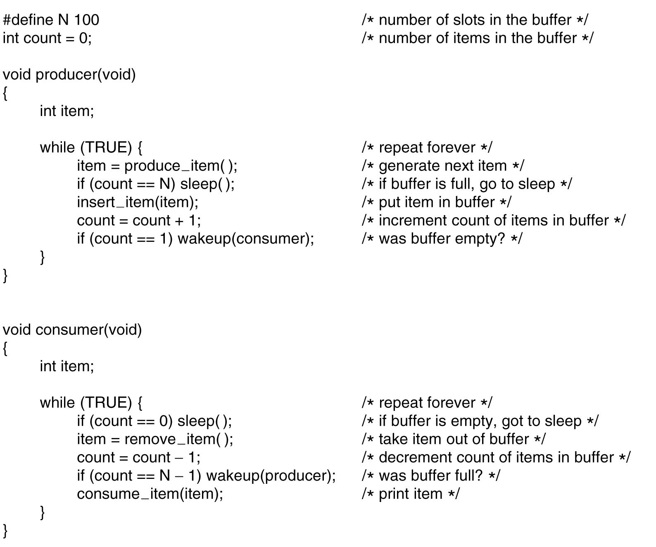
The Bounded-Buffer Problem
Reminder: Producer-Customer problem with race condition

Slide 37
The Bounded-Buffer Problem
Producer-Customer Bounded-Buffer Problem
We need three semaphores:
A semaphore mutex (initialized to 1) to have mutual exclusion on buffer access.
A semaphore full (initialized to 0) to synchronize producer and consumer on the number of consumable items.
A semaphore empty (initialized to n) to synchronize producer and consumer on the number of empty spaces.
Shared data:
semaphore mutex = 1;
semaphore empty = BUFFER_SIZE;
semaphore full = 0;

Slide 38
The Bounded-Buffer Problem
Producer-Customer Bounded-Buffer Problem
Producer Process:
do {
…
produce an item in next_produced
…
/* must perform wait(empty) before wait(mutex) */
wait(empty);
wait(mutex);
…
add next_produced to buffer
…
signal(mutex);
signal(full);
} while (TRUE);

Slide 39
The Bounded-Buffer Problem
Producer-Customer Bounded-Buffer Problem
Consumer Process:
do {
/* must perform wait(full) before wait(mutex) */
wait(full);
wait(mutex);
…
remove an item from buffer to next_consumed
…
signal(mutex);
signal(empty);
…
consume the item in next_consumed
…
} while (TRUE);

Slide 40
The Bounded-Buffer Problem
Producer-Customer Bounded-Buffer Problem
Remarks (from consumer point of view):
Putting signal(empty) inside the critical section of the consumer (instead of outside) has no effect since the producer must always wait for both semaphores before proceeding.
The consumer must perform wait(full) before wait(mutex), otherwise deadlock occurs if consumer enters critical section while the buffer is empty (full.value == 0).
The producer must perform wait(empty) before wait(mutex), otherwise deadlock occurs if producer enters critical section while the buffer is full (empty.value == 0).
Conclusion
using semaphores is a difficult art ...

Slide 41
Readers-Writers Problem
A data set (data repository) is shared among a number of concurrent processes:
Readers
only read the data set; they do not perform any updates.
Writers
can both read and write.
Problem
Multiple readers are allowed to read at the same time.
Only one single writer can access the shared data at the same time.

Slide 42
Readers-Writers Problem
Readers-Writers Dynamics
Any number of reader activities and writer activities are running.
At any time, a reader activity may wish to read data.
At any time, a writer activity may want to modify the data.
Any number of readers may access the data simultaneously.
During the time a writer is writing, no other reader or writer may access the shared data.

Slide 43
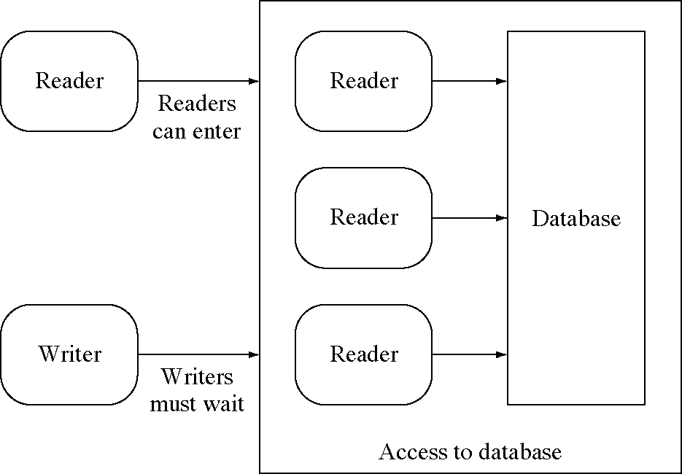
Readers-Writers Problem
Readers-Writers with active readers

Slide 44
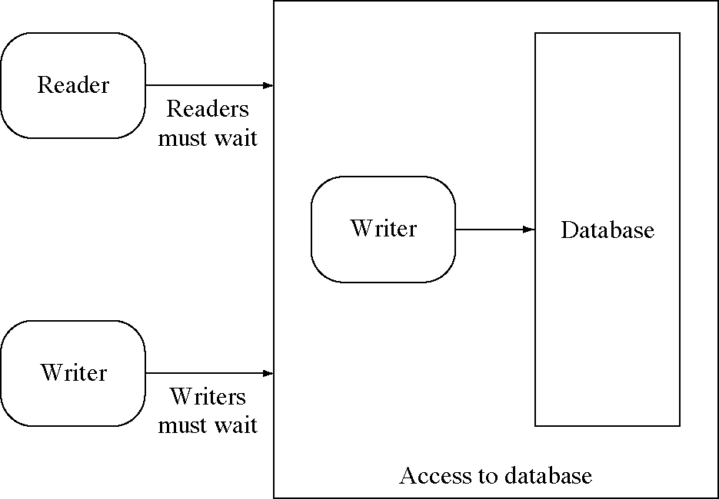
Readers-Writers Problem
Readers-Writers with an active writer

Slide 45
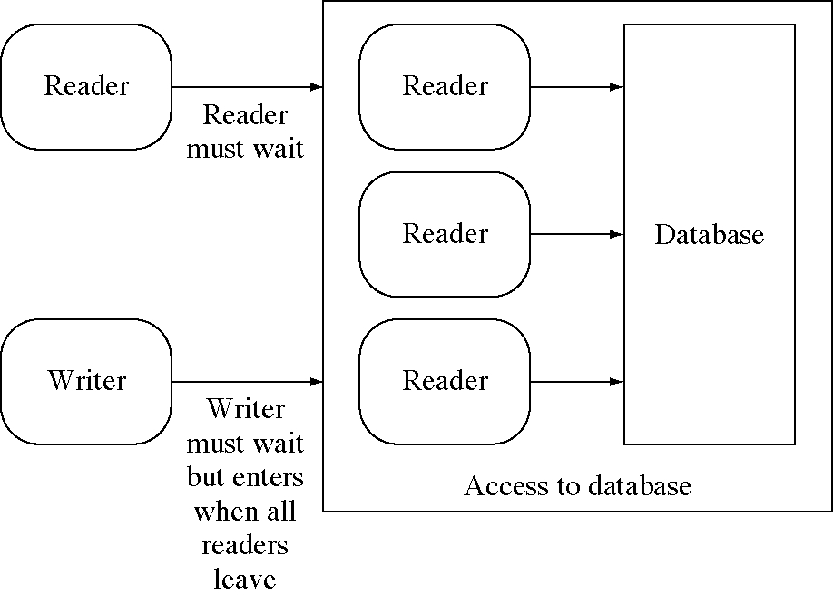
Readers-Writers Problem
Should readers wait for waiting writer?

Slide 46
Readers-Writers Problem
There are various versions with different readers and writers preferences:
The First Readers-Writers Problem
It is requires that no reader will be kept waiting unless a writer has obtained access to the shared data.
In a solution to this case writers may starve.
The Second Readers-Writers Problem
It is requires that once a writer is ready, no new readers may start reading.
In a solution to this case readers may starve.
Recap: Starvation
A process may never be removed from the semaphore queue in which it is suspended.

Slide 47
Readers-Writers Problem
Solution to the First Readers-Writers Problem
read_count (initialized to 0) counter keeps track of how many processes are currently reading.
mutex semaphore (initialized to 1) provides mutual exclusion for updating read_count.
rw_mutex semaphore (initialized to 1) provides mutual exclusion for the writers; it is also used by the first or last reader that enters or exits the critical section.

Slide 48
Readers-Writers Problem
Solution to the First Readers-Writers Problem
Shared data
semaphore mutex = 1;
semaphore rw_mutex = 1;
int read_count = 0;
Writer Process:
do {
wait(rw_mutex);
…
writing is performed
…
signal(rw_mutex);
} while(TRUE);

Slide 49
Readers-Writers Problem
Solution to the First Readers-Writers Problem
Reader Process:
do {
wait(mutex);
read_count++;
if (read_count == 1)
wait(rw_mutex);
signal(mutex);
…
reading is performed
…
wait(mutex);
read_count--;
if (read_count == 0)
signal(rw_mutex);
signal(mutex);
} while(TRUE);

Slide 50
Readers-Writers Problem
Reader–Writer Locks
The readers–writers problem and its solutions have been generalized to provide reader–writer locks on some systems.
Acquiring a reader–writer lock requires specifying the mode of the lock: either read or write access.
Only to read shared data requests the lock in read mode, to modify the shared data in write mode.
Multiple processes can concurrently acquire a lock in read mode, but only one process may acquire the lock for writing, as exclusive access is required for writers.
Reader–writer locks are most useful in the following situations:
It is easy to identify which processes only read shared data and which processes only write shared data.
It has more readers than writers.
Reader–writer locks generally require more overhead to establish than semaphores or mutual-exclusion locks. The increased concurrency of multiple readers compensates for the overhead in setting up the reader–writer lock.

Slide 51
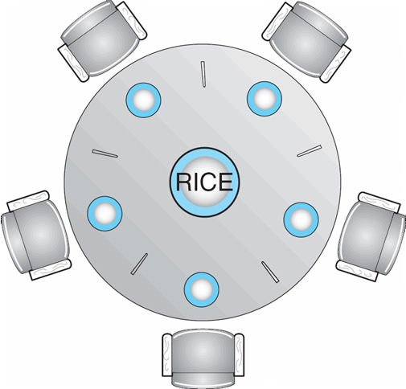
Dining-Philosophers Problem
Philosophers spend their lives alternating between thinking and eating. Five philosophers can be seated around a circular table. There is a shared bowl of rice. In front of each one is a plate. Between each pair of philosophers there is a single chopstick, so there are five chopsticks.
When a philosopher thinks, she does not interact with her colleagues. From time to time, a philosopher gets hungry and tries to pick up the two chopsticks that are closest to her.
A philosopher may pick up only one chopstick at a time. Obviously, she cannot pick up a chopstick that is already in the hand of a neighbor.
When a hungry philosopher has both her chopsticks at the same time, she eats without releasing the chopsticks. When she is finished eating, she puts down both chopsticks and starts thinking again.

Slide 52
Dining-Philosophers Problem
Dining-Philosophers dynamics for each philosopher
do {
thinks for a while;
gets the left chopstick;
gets the right chopstick;
eats for a while;
puts the two chopsticks down;
while (TRUE)
The challenge is to grant requests for chopsticks while avoiding deadlock and starvation. This Illustrates the difficulty of allocating resources among process without deadlock and starvation.
Deadlock can occur if everyone tries to get their chopsticks at once. Each gets a left chopstick, and is stuck, because each right chopstick is someone else’s left chopstick.
One simple solution is to represent each chopstick with a semaphore. Each philosopher is a process trying to grab a chopstick by executing a wait() operation on that semaphore. She releases her chopsticks by executing the signal() operation on the appropriate semaphores.

Slide 53
Dining-Philosophers Problem
Solution to the Dining-Philosophers Problem
Shared data:
semaphore chopstick[5];
Initialization:
for (int i = 0; i < 5; i++) {
chopstick[i].value = 1;
}
Process P_{i}:
do {
think for a while
wait(chopstick[i]); /* acquire the left chopstick */
wait(chopstick[(i + 1) mod 5]); /* acquire the right
chopstick */
eat for a while
signal(chopstick[(i + 1) mod 5]); /* release the right
chopstick */
signal(chopstick[i]); /* release the left chopstick */
} While (TRUE)

Slide 54
Dining-Philosophers Problem
Although this solution guarantees that no two neighbors are eating simultaneously, it could create a deadlock.
Suppose that each of the five philosophers grabs her left chopstick at the same time. All the elements of chopstick will now be equal to 0. Any requirement for right chopstick will be delayed forever.
Possible solutions to avoid deadlock:
Solution 1. Allow at most four philosophers to be sitting at the table that try to eat simultaneously. Then one philosopher can always eat when the other three are holding one chopstick.
Solution 2. Allow a philosopher to pick up the chopsticks only if both are available (picking must be done in a critical section).
Solution 3. Use an asymmetric solution:
an odd-numbered philosopher picks up first the left chopstick and then the right chopstick. Even-numbered philosopher picks up first the right chopstick and then the left chopstick.
Any satisfactory solution to the dining-philosophers problem must guard against the possibility of starvation. A deadlock-free solution does not necessarily eliminate the possibility of starvation.

Slide 55
Dining-Philosophers Problem
Implementation of Solution 1.
Use another semaphore T that would limit at four, the number of philosophers “sitting at the table”.
Shared data:
semaphore chopstick[5], T;
Initialization:
for (int i = 0; i < 5; i++)
chopstick[i].value = 1;
T.value = 4;
Process P_{i}:
do {
/* think for a while */
wait(T);
wait(chopstick[i]);
wait(chopstick[(i + 1) mod 5]);
/* eat for a while */
signal(chopstick[(i + 1) mod 5]);
signal(chopstick[i]);
signal(T);
} While (TRUE);

